Slide 1
Xtron Educate A Child Project
By Damilola Ogunleke

Slide 2
Professional Background:
➢ 2012-2017: Bachelors Degree in Economics from University of Lagos, Nigeria.
➢ 2017-2019: Enterprise Risk Certified Professional (ERMCP)
➢ 2019-2022: Executive marketer and operations officer at Zenith bank Nigeria
➢ 2023- Present: Data Analyst Associate at Xtron, managing organization-wide data, business metrics, impact metrics, departmental KPIs and presenting reports to management for decision-making.
To excel in my varied background, I have developed and honed skills in MS Office & G-Suite especially MS Excel & Google Sheets for Data Analysis, Data visualization using Tableau and PowerBi, Data Query using tools like Bigquery, power bi and R studio.

Slide 3
Project Description:
I am a Data Analyst working for Xtron and was selected to work with the Educate a child charity team.
Within the Fundraising team, my objectives are to:
Increase the number of donors in our database.
Increase the donation frequency of our donors.
Increase the value of donations in our database.
I needed to present insights from the donation data to my team and inform them my fundraising strategy to increase donations for the following year.
I used the data sets FOR_Donation_Data and FOR_Donor_Data to answer the business problem.
I applied these SQL commands to analyse data: JOIN, ORDER BY, WHERE, BETWEEN, AND, OR, SUM(), COUNT(), AVG(), GROUP BY, HAVING.
Also, I used Root Cause Analysis to understand the problem and ask right questions. As a result, I have found out crucial insights of provided data sets, prepared visualisations, and report for my team.

Slide 4
ROOT CAUSE ANALYSIS
The business problem is that for charity organizations, it is very hard to grow funding. Therefore, they must search for more donors, who can donate regularly and will increase the value of their donations.
To understand the problem, I needed to analyse existing data bases of Donors and Donations.
Also, I should present crucial numbers and visualisations of our data sets. I decided to ask some questions to dig the problem deeper:
How many donors we have in existing database?
What is the amount of their donations?
What is the frequency of the donations?
Who are the top 10 donors?
Does the amount of donations depends on gender, job field, university degree, car?

Slide 5
Also, I realized that I should figure out what is happening, why some people donate regularly and some of them do not. I had to specify main symptoms and trends of the dataset.
Moreover, I applied Root Cause Analysis to ask:
Why do we not have as many donors as we need?
Why donors’ willingness and capability to donate is vary?
Why in our database we can not see when people joined our organisation and how long they stay with us?
Why we do not add their date of birth to our dataset to research what is the age group of our donors?
Why do we not collect information how actually donors learned about Education for ALL to be able to promote our organisation via these channels?

Slide 6
Findings & Insights

Slide 7
I have been provided with 2 relational databases such as: FO_Donation_Data and EFO_Donor_Data to answer the business problem.
SQLite Database Management System was used to find out main insights.
Donation Dataset includes such data:
- Id
- First name
Last Name
Email
- Gender
- Job field
- Donation
- State
- Shirt Size
Donor Dataset includes such data:
Id , Donation frequency , University , Car , Second language , Favourite colour , Movie genre
Both data sets were imported into SQLite.

Slide 8
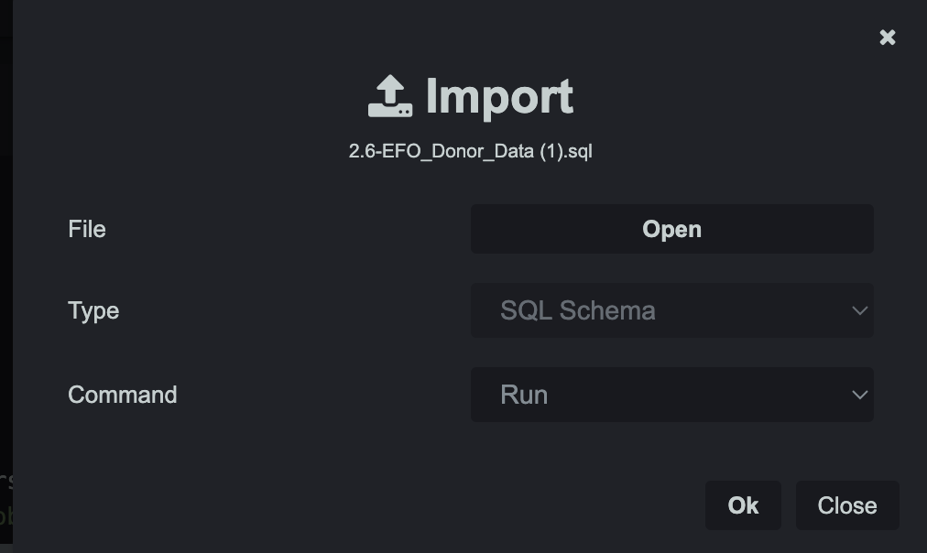
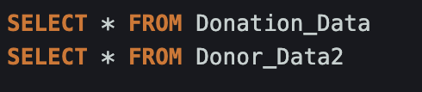
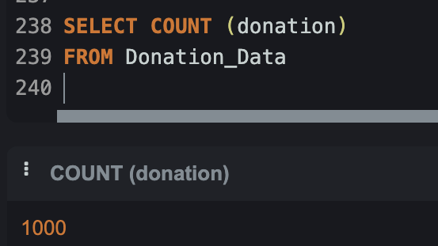
Both data sets were imported into SQLite.
SELECT statement was used to fetch data from a database
To find the total number of donors with the COUNT() Function, I used a command like this:

Slide 9
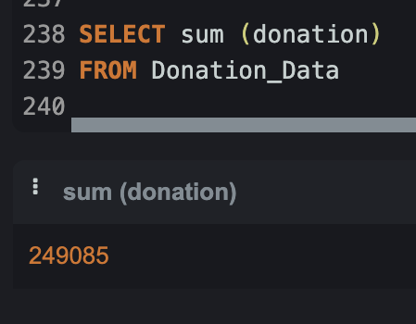
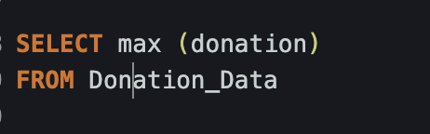
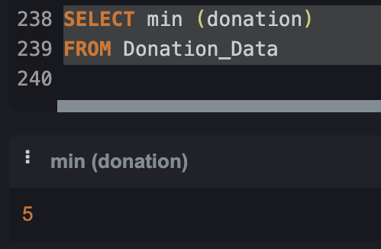
To find the total sum of donations I used SUM():
MAX() I applied to find the largest amount of donations:
MIN() to return the smallest value of donations:

Slide 10
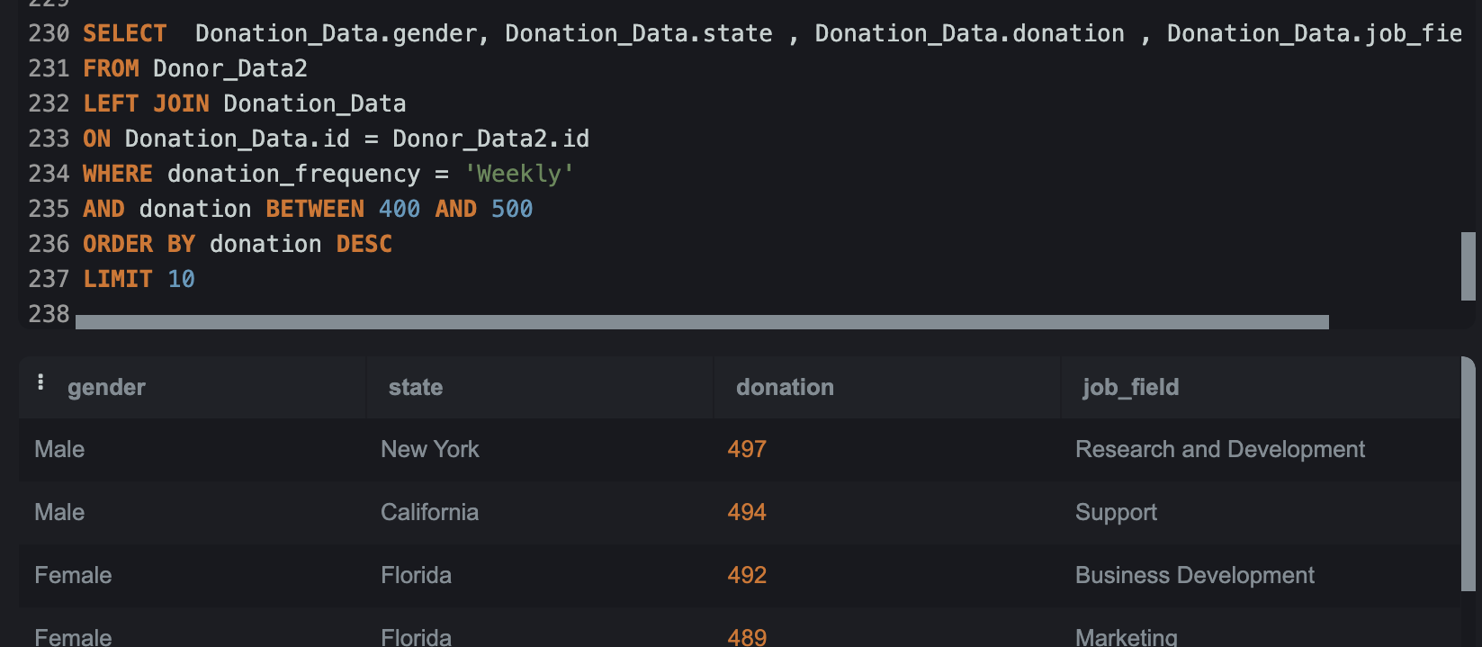
Top 10 donors: The INNER JOIN clause allows us to join different columns from multiple tables together. WHERE was used to filter the result of a set to include only rows where a specified condition is true. ORDER BY function with DESC order was used to order the donor data by the highest to lowest donations.

Slide 11
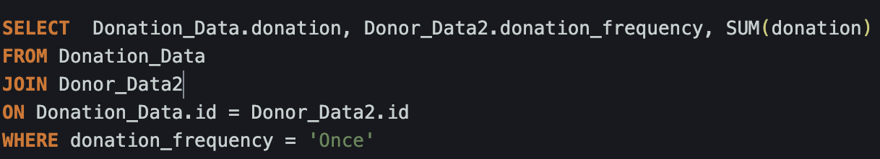
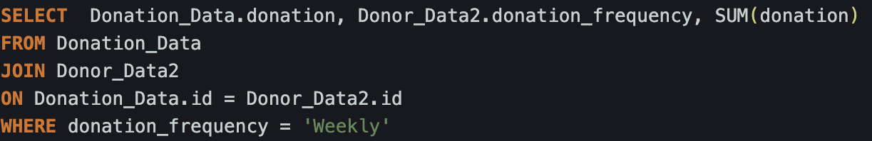
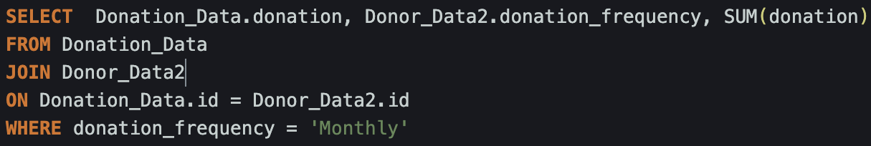
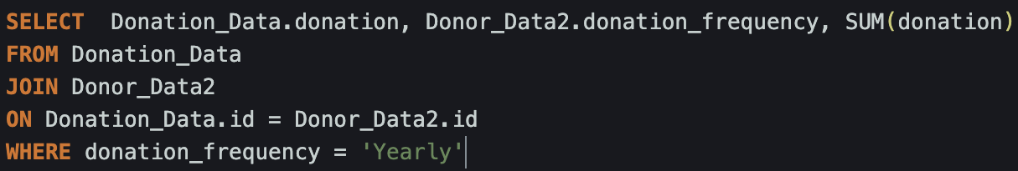
Also I used INNER JOIN to figure out the amount of donations Once, Weekly, Monthly, Yearly.

Slide 12
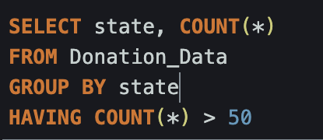
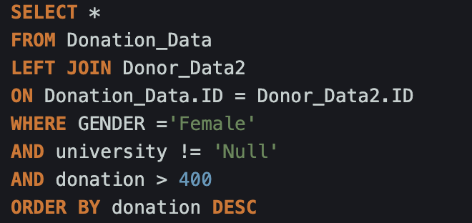
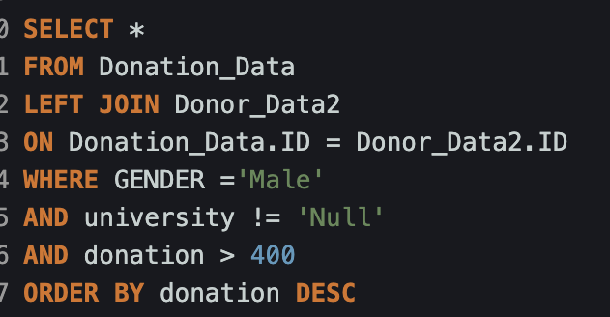
Here, we want to see how many States have over 50 donors. The HAVING clause restricts the query to states with 50 or more donors.
I used LEFT JOIN command on Donor_Data and Donation_Data to understand how many females and males with university education donated more than $400.

Slide 13
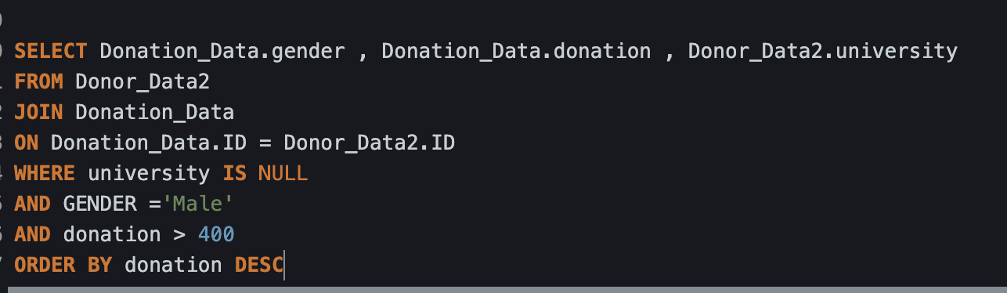
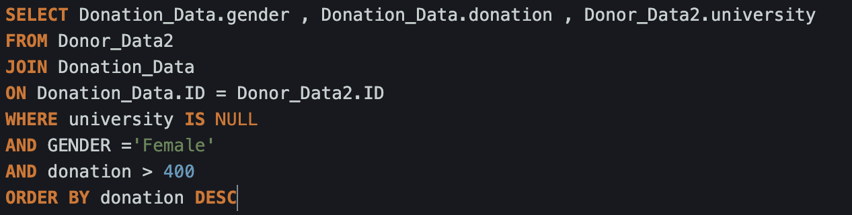
Also, I found out how many males and females without university education donated more than $400.

Slide 14
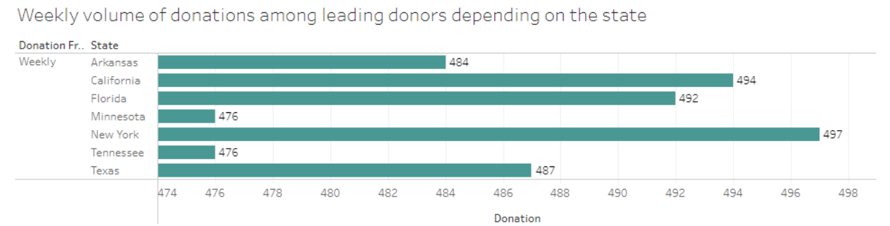
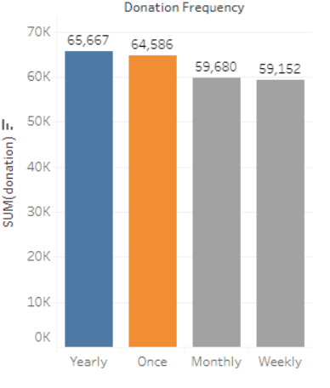
Tableau was used as a very powerful tool for data analysis and visualisation. Thus, the highest amounts of donations weekly coming from California, New York and Florida.
Next visualisation clearly demonstrate that we receive majority of donations with frequency Yearly and Once.

Slide 15
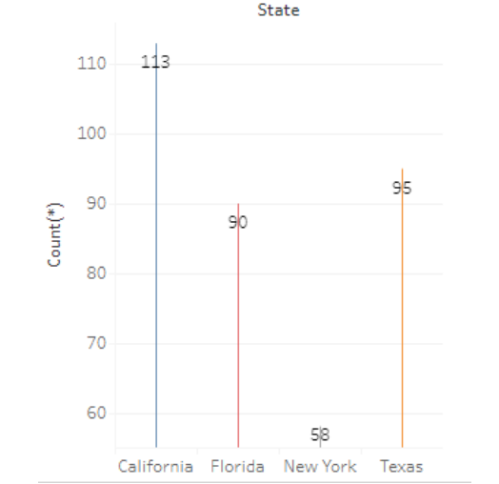
Majority of our donors live in California, Texas and Florida

Slide 16
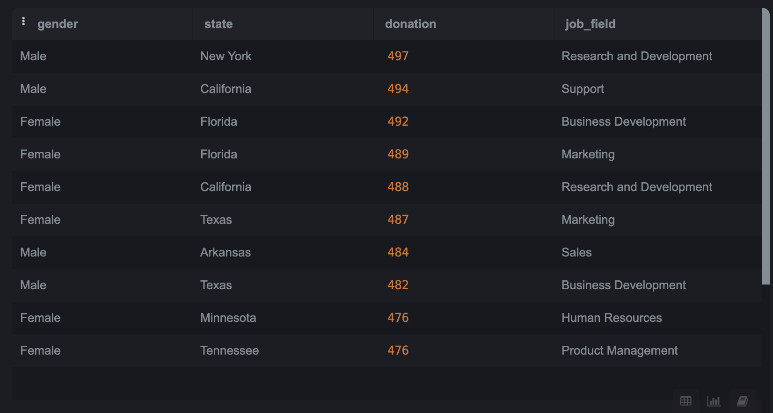
Findings and Recommendations
As a result of data set analysis, I have found out:
The total number of donors we have in the database is 1000
The sum of donations we collected is $249085
The largest amount of donations is $500
The smallest amount of donation is $5
Top 10 donors, who donate weekly between $400 and $500:
:

Slide 17
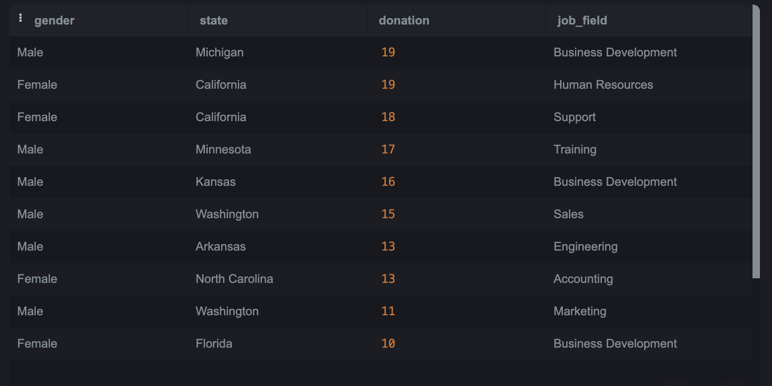
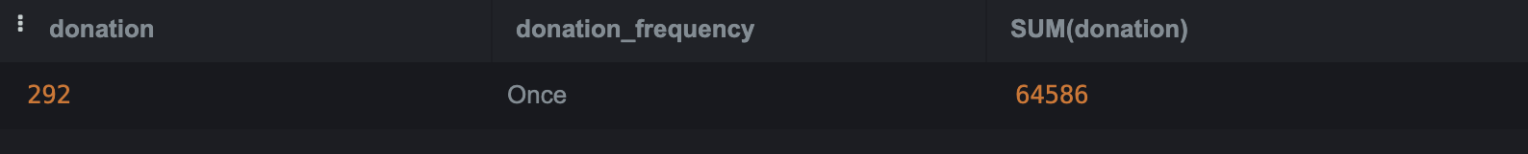
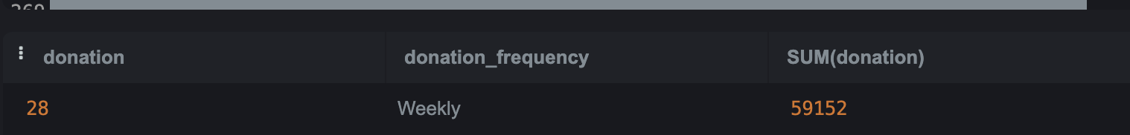
Top 10 donors with negative ratio, who donate weekly between $5 and $20
Thus, we can see that amount of donations are not really depends on how expensive is donors’ car, they are from different states where income is vary.
Also, we can notice that majority of donors have university education, no matter what amounts they donate.
Amount of donations and frequency:

Slide 18
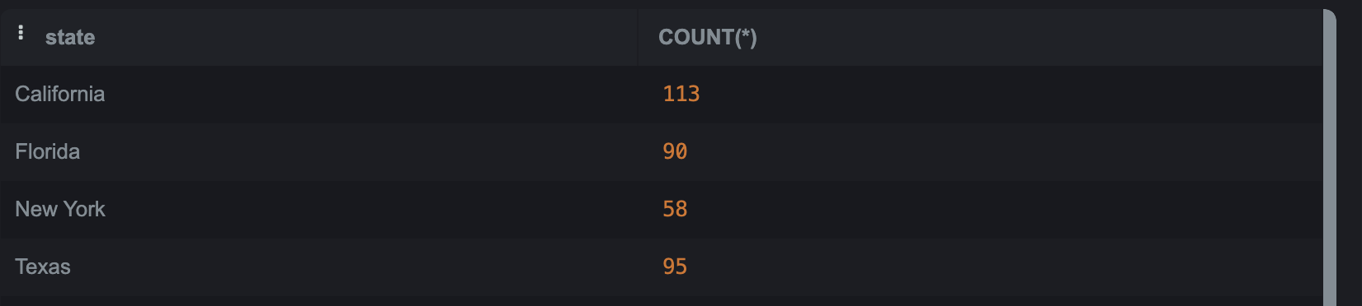
We can understand that among 1000 donors we have in our data base, only 753 are active donors, who donate with different frequency. 1000-753 = 247 are not active donors, they do not provide donations at all.
Also, we can notice that majority of donors donate Once or Yearly. Thus, we should increase the frequency.
States with more than 50 donors:

Slide 19
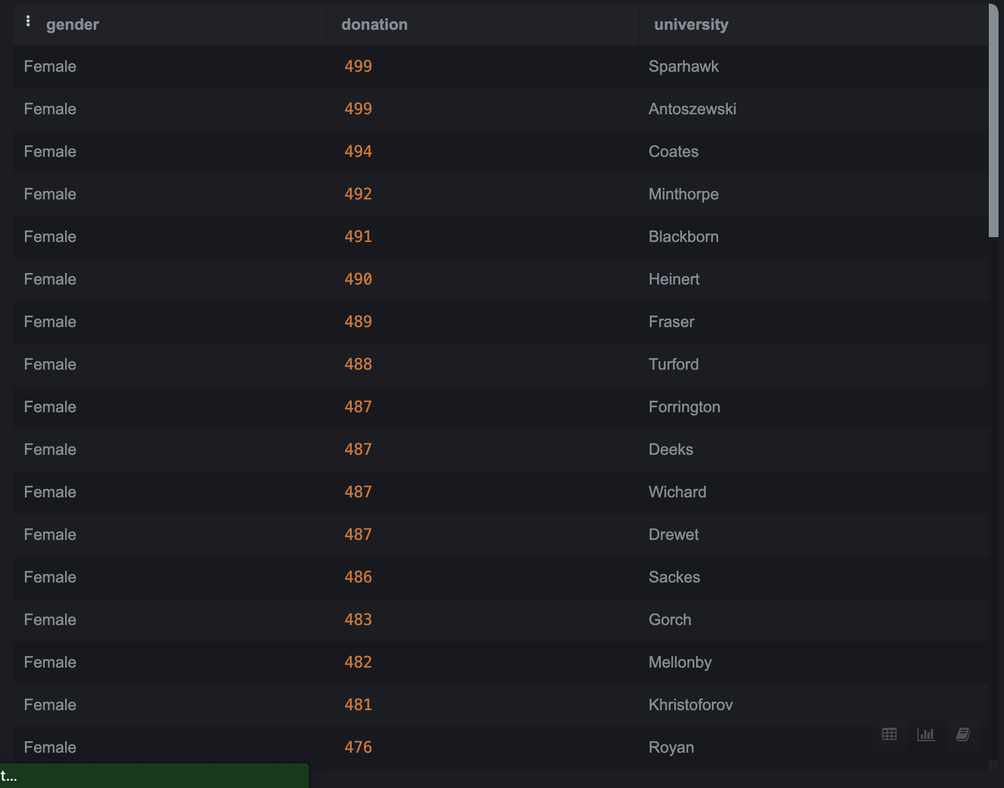
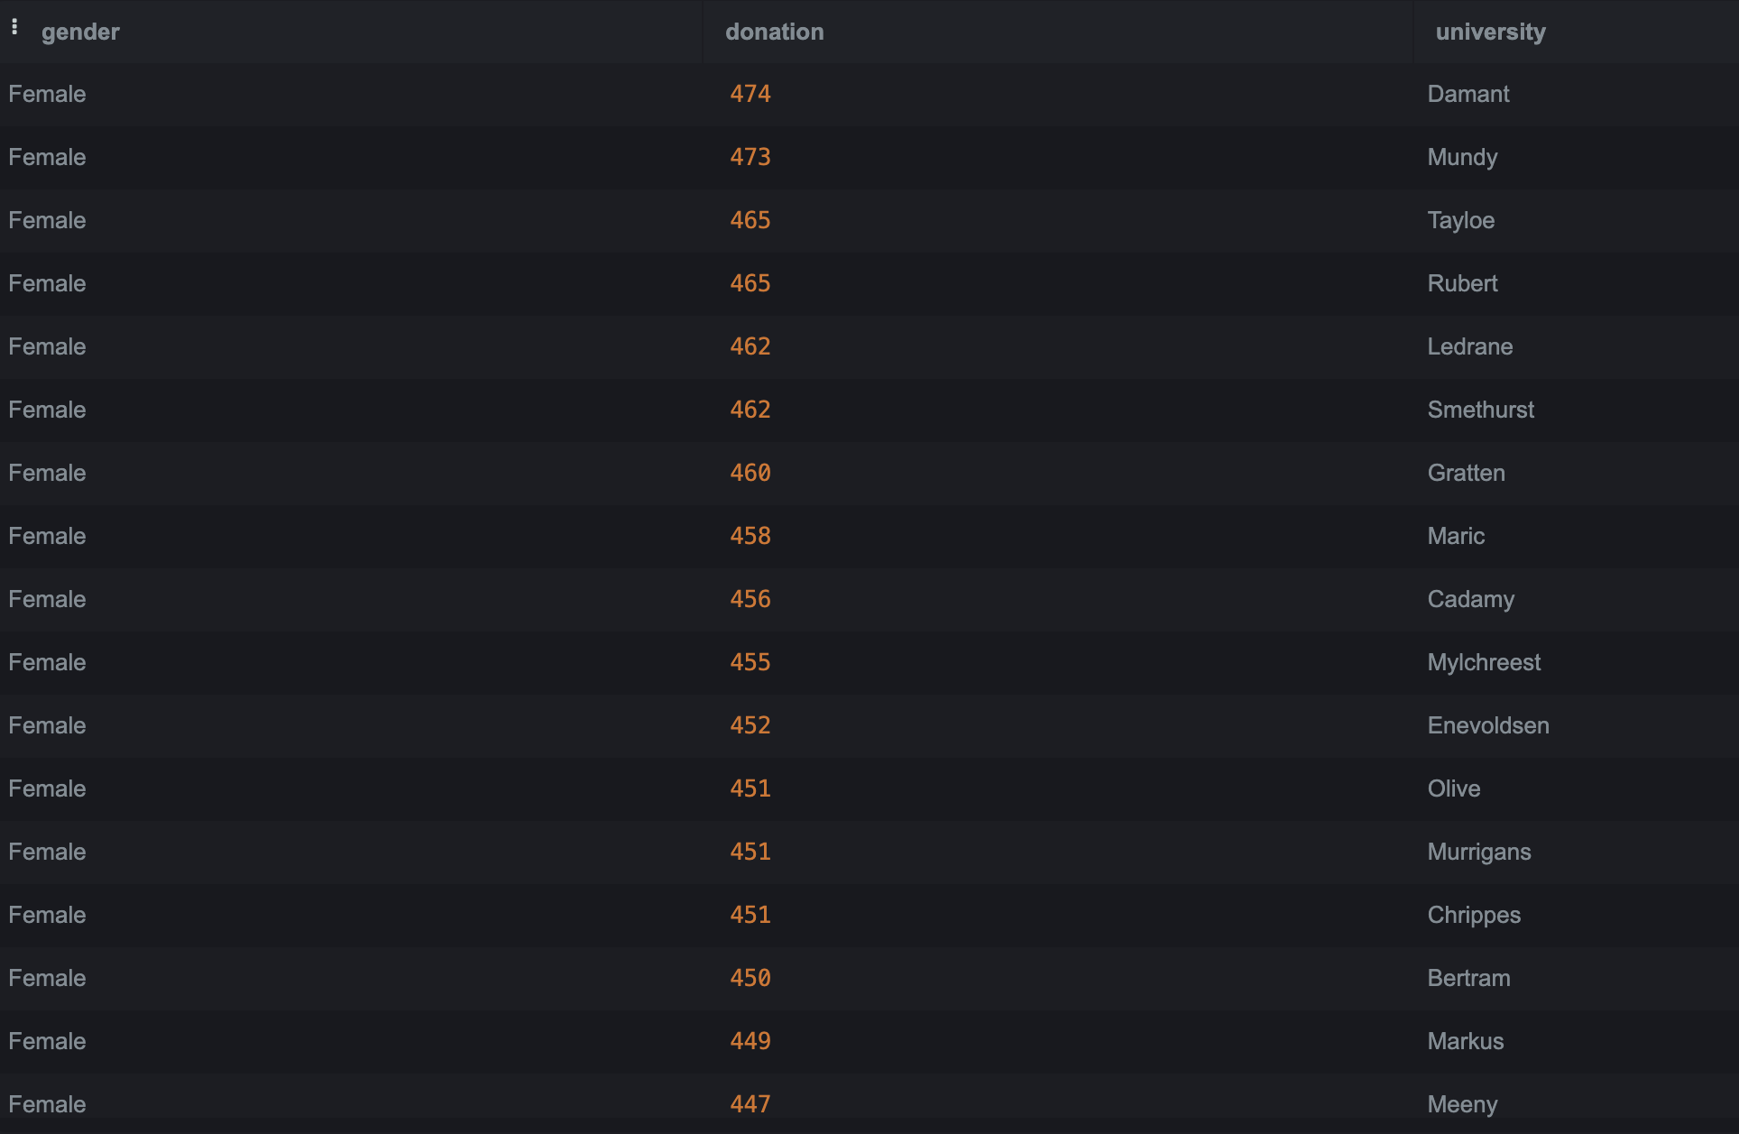
66 Females with university education donated more than $400:

Slide 20
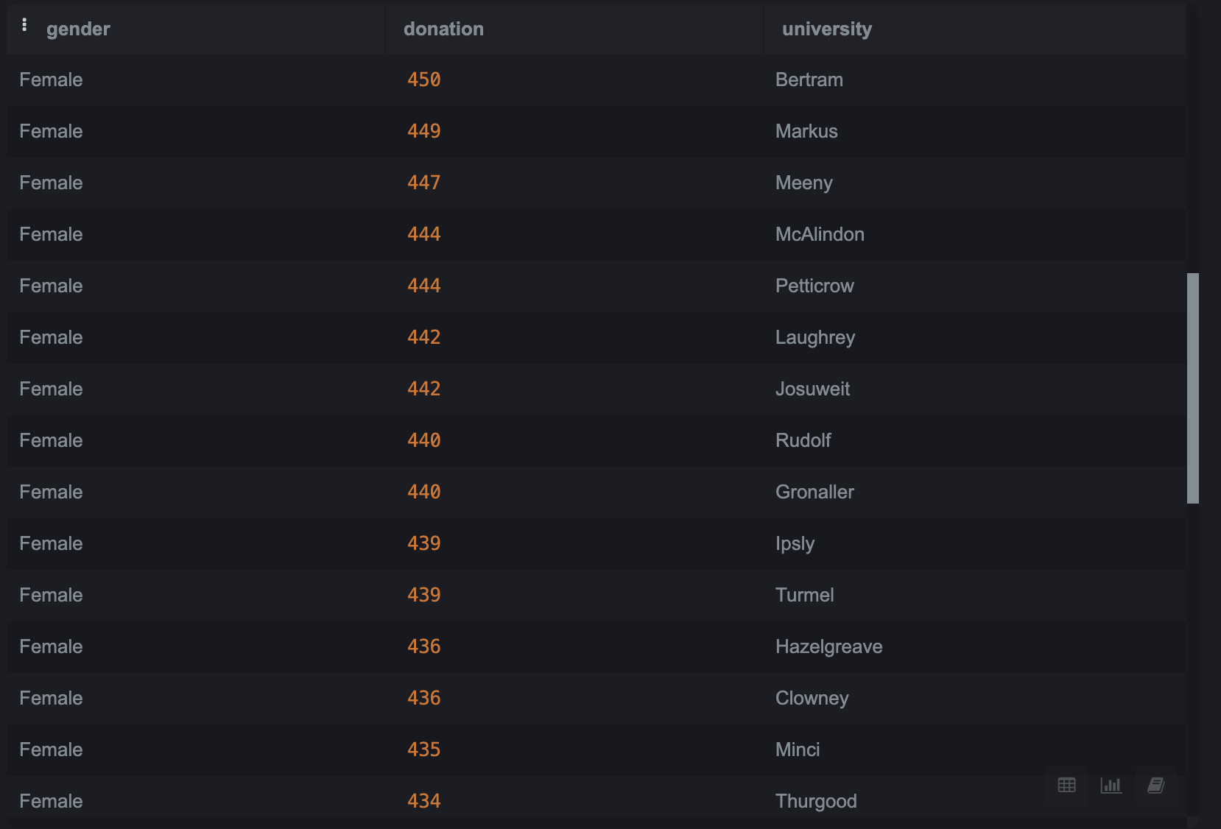
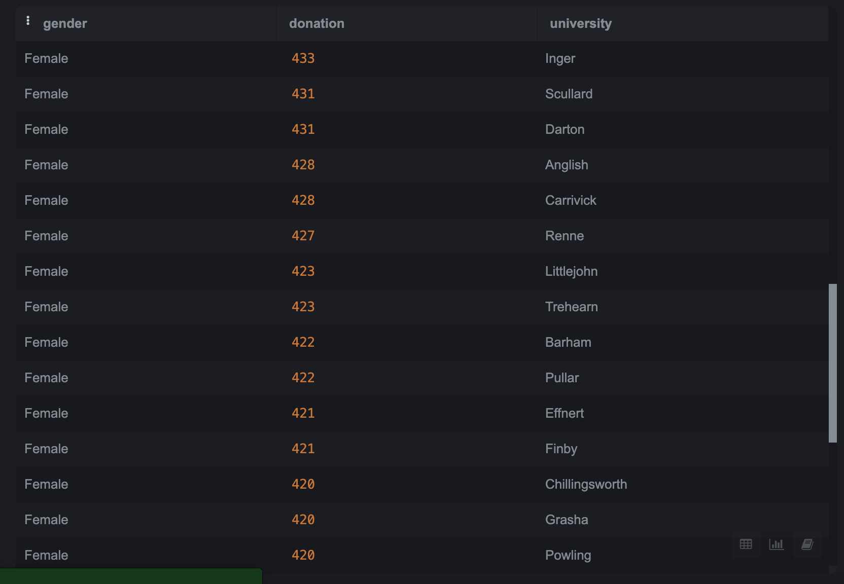

Slide 21
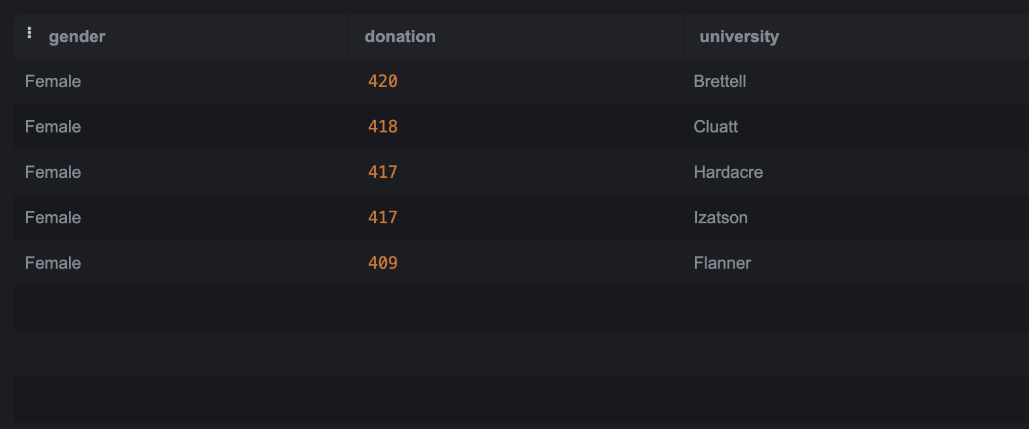
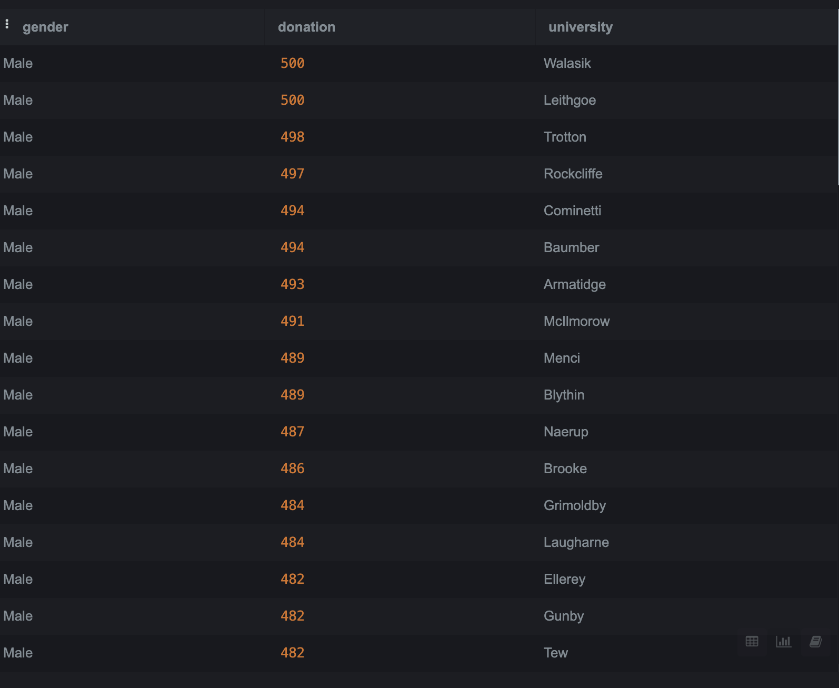
88 Males with university education donated more than $400:

Slide 22
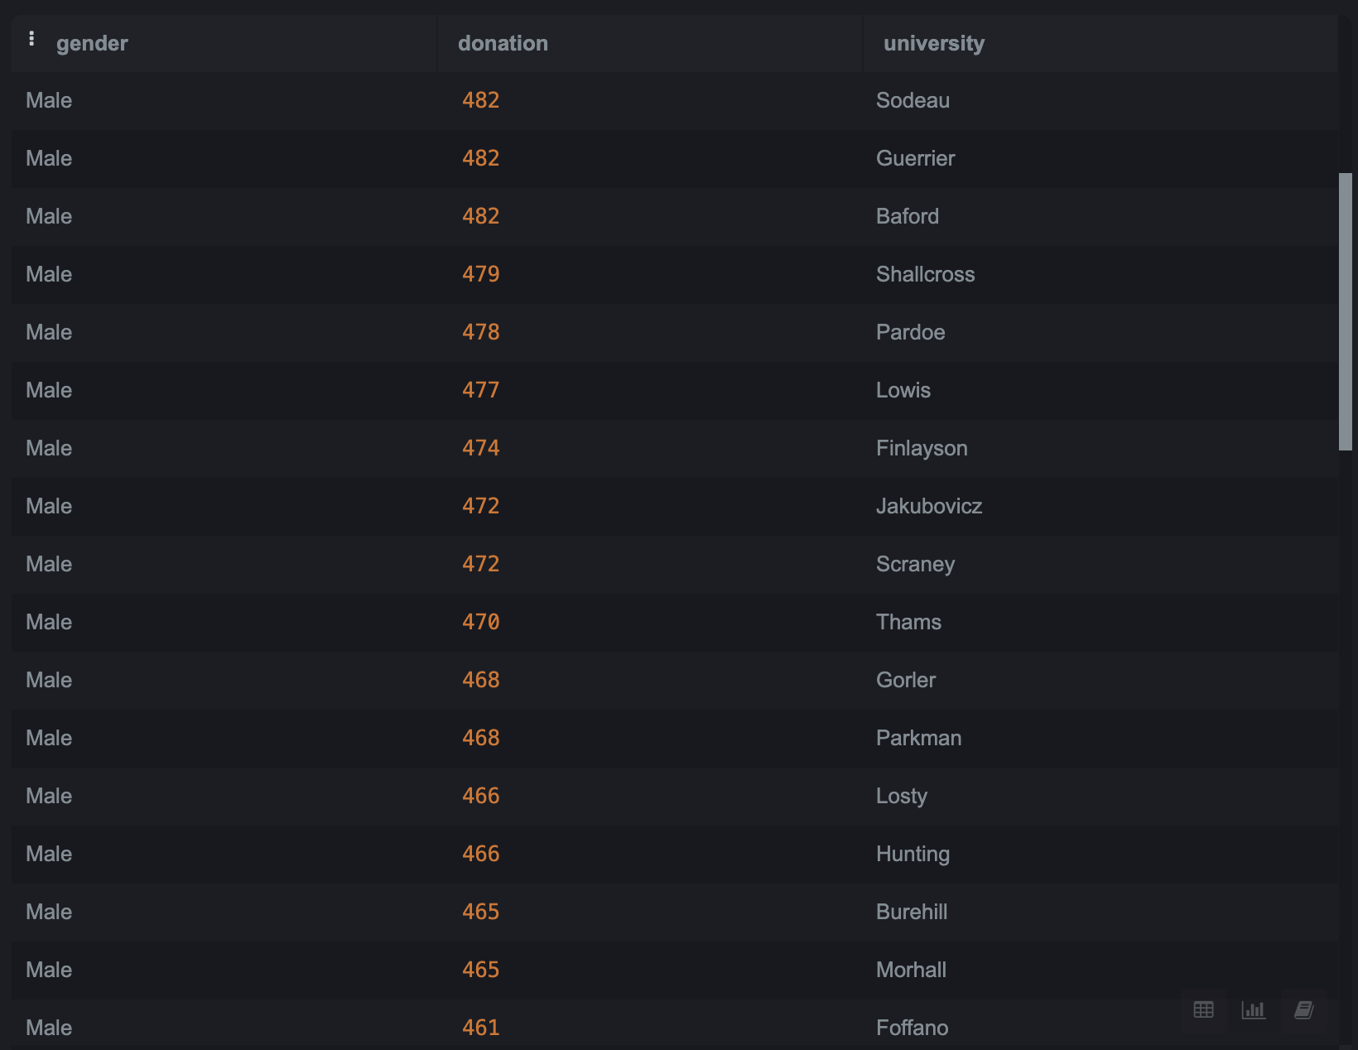
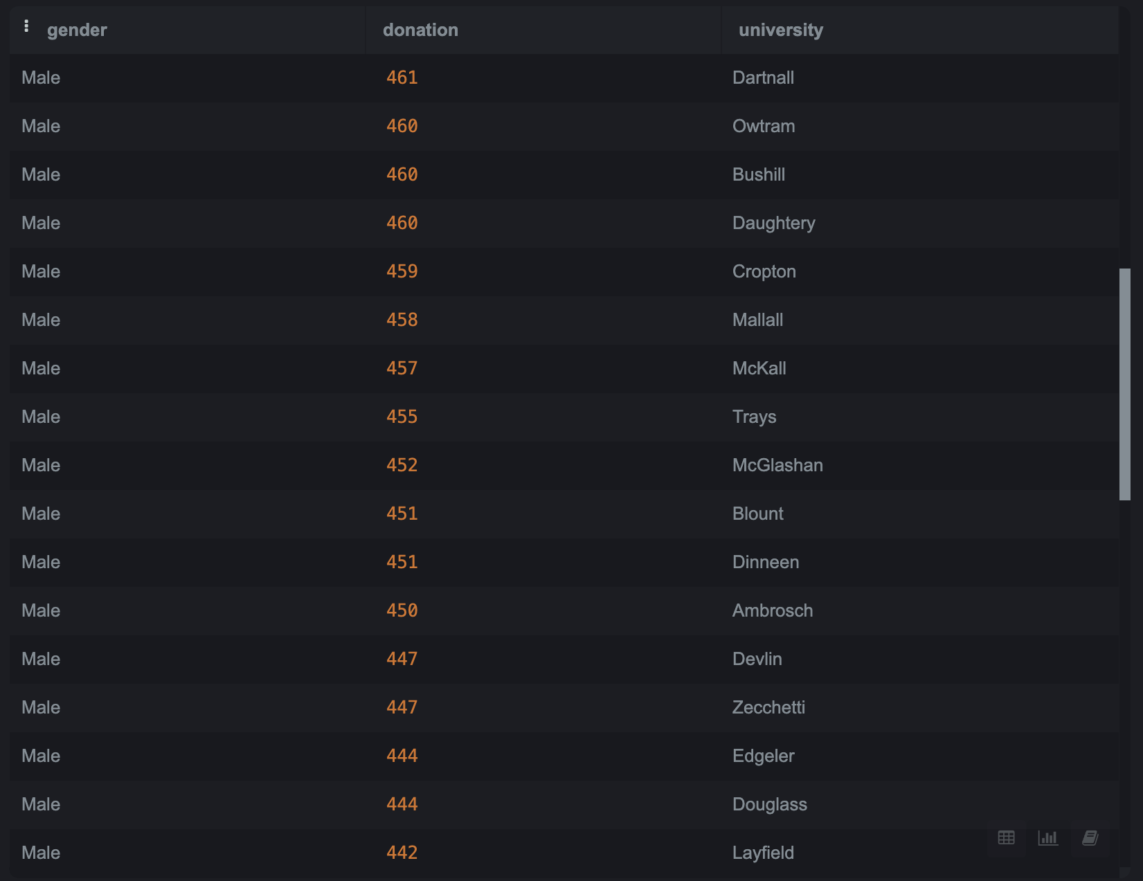

Slide 23
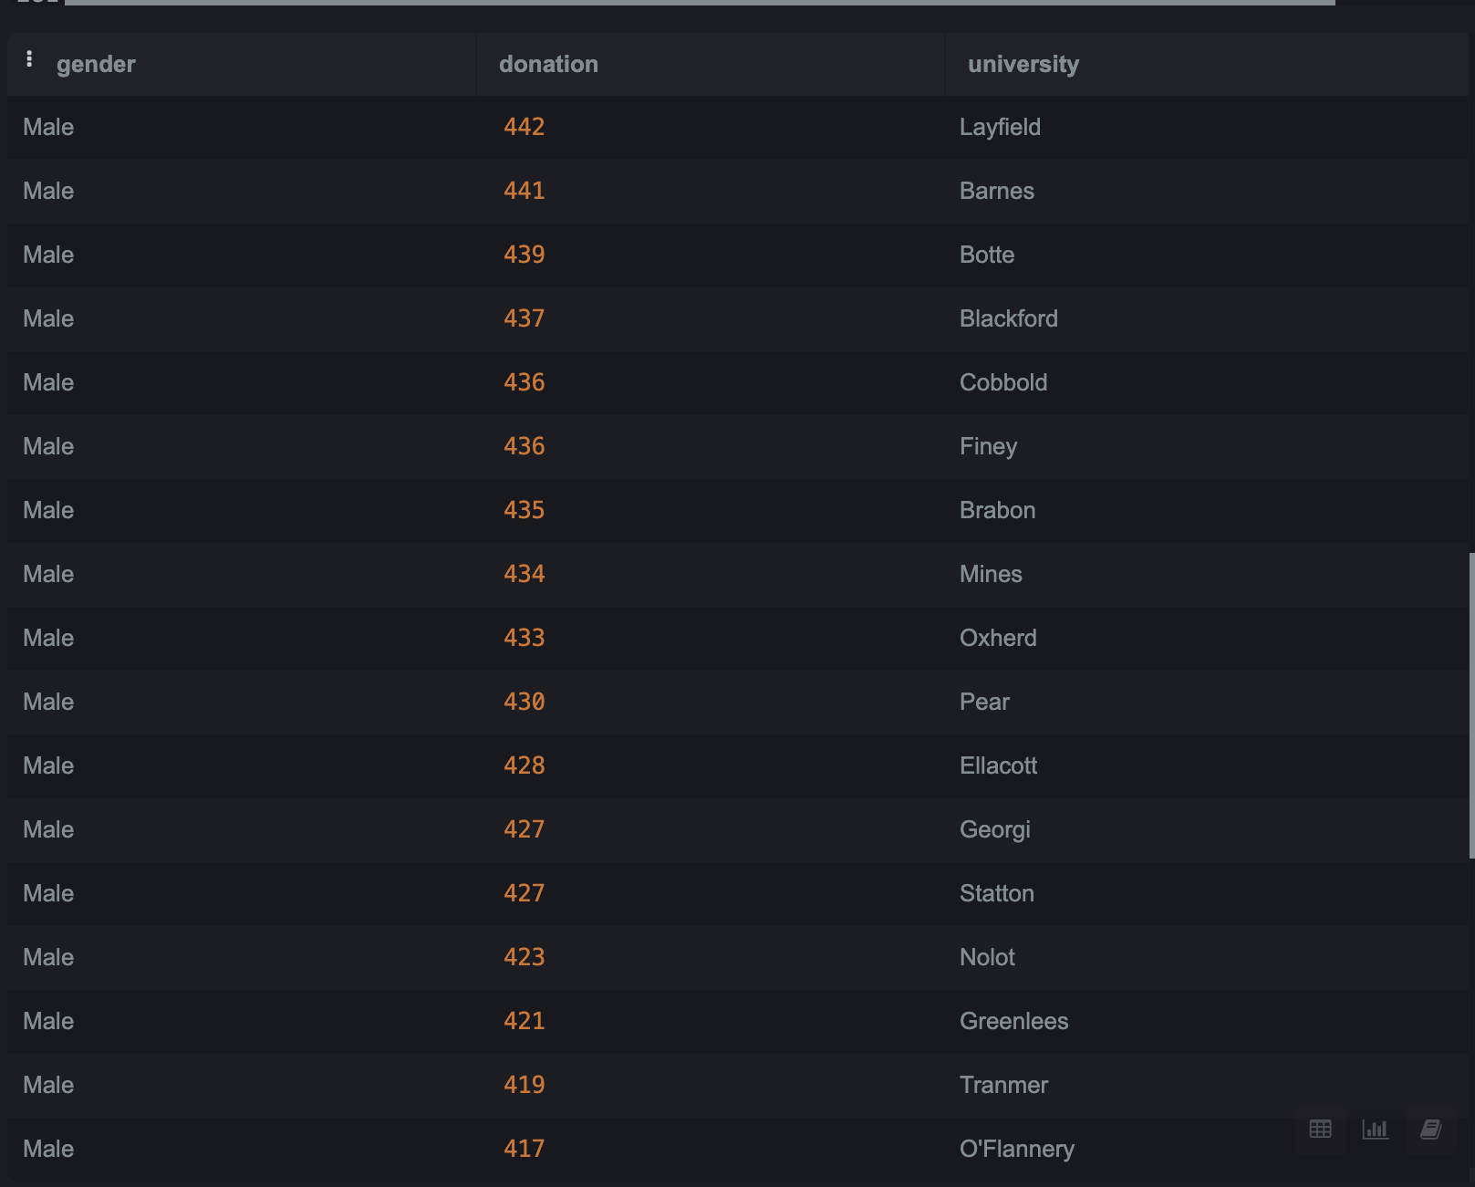
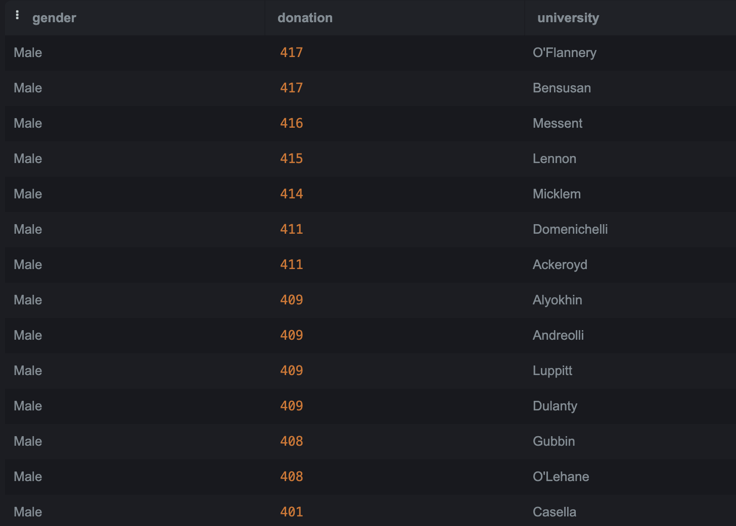

Slide 24
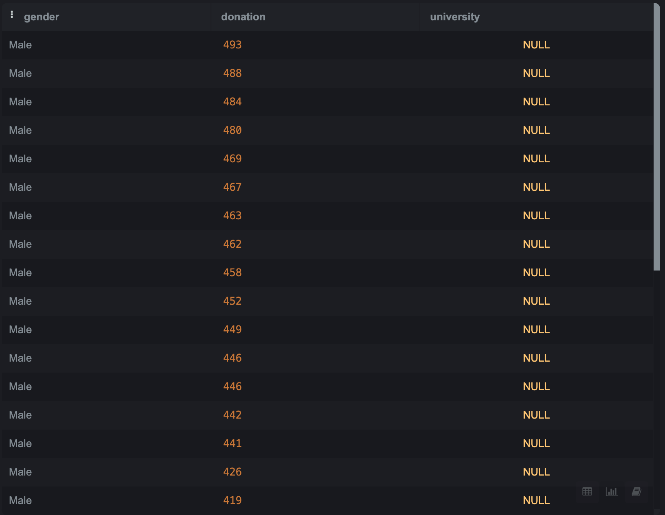
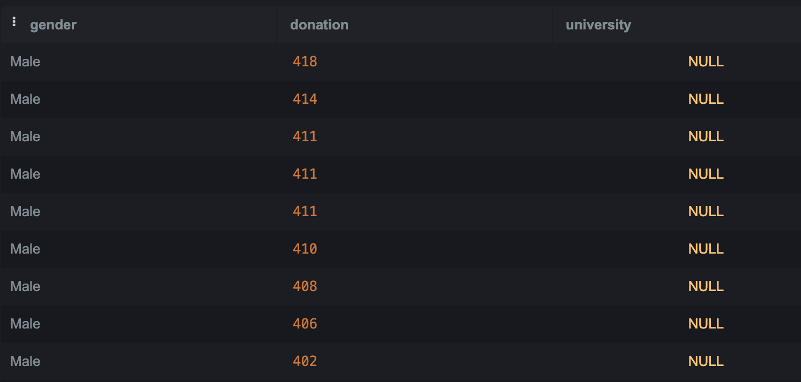
26 Males without university education donated more than $400:

Slide 25
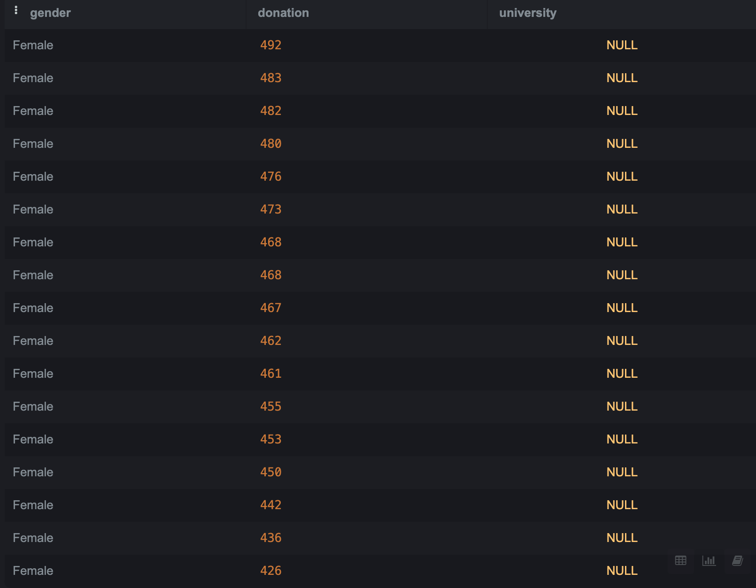
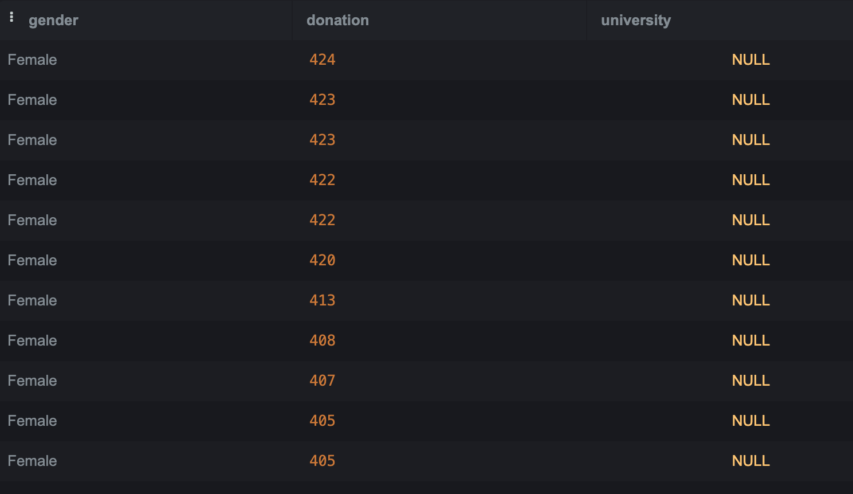
28 Females without university education donated more than $400:

Slide 26
Thus, educated donors, especially males donate big amounts. Among people with NULL university education the number of males and females, who donate more than $400 is almost the same. Therefore, we can see that our target audience is males and females with university education.

Slide 27
Conclusion
I have analysed 2 data sets FO_Donation_Data and EFO_Donor_Data to help Education for ALL to understand business problem of involving new donors more deeply and find a way to rase more donations with regular frequency.
Therefore, our donors are very dissimilar people. They live in different states, work in absolutely unsimilar job fields, some of them have university education and some of them no. Amount of donation are also vary between $5 and $500 dollars.
However, there are some crucial points that we need to count and try to use for increasing charity activeness of our donors and their donations.
I have found out that frequency of Yearly and Once donations is much higher than Monthy. Weekly frequency is very low. So, we need to work on improvement of donation frequency, especially Weekly donations. Also, we have some people in our base who do not donate at all, so maybe we should contact them and try to realise why they are not active donors.
Also, we need to attract more donors from other states, since now majority of them are from Florida, California and Texas.
Another very significant point is that majority of our top donors, who donate between $400 and $500 have university education. Gender is not crucial thing.
Thus, we can notice that people, who are educated themselves are happy to support others to get education. Some people with NULL education also provide big amounts, but not a big number of them.

Slide 28
In conclusion, we must concentrate to improve our databases, add more useful information about our donors. There is lack of valuable data. Car or movie genre are not useful to solve our business problems.
We must find useful channels for promoting our charity organisation. Since we have good support among educated people, we could try to spread the word in university graduates’ societies about us.

Slide 29
Thank you!

